Slide 1

Structuring a UI Layout with Grids, Color Applications, & Auto Layout in Figma

Slide 2
Grid system in Figma
Figma grids are visual aids that help organize design elements by providing a structured system of columns, rows, or both.
Designers use this framework to place and align text, images, and other elements. This system ensures proper alignment and a structured layout.
Create separate frames for desktop, tablet, and mobile and set up a responsive grid system with a "Stretch" type to ensure your design looks good on all devices.

Slide 3
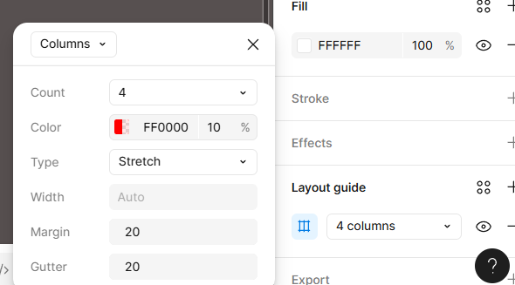
Set up grids in Figma :
Select a frame: Choose the frame you want to add a grid to.
Open the properties panel: Find the Layout Grids section in the right-hand sidebar.
Add a grid: Click the + icon next to Layout Grids.
Choose a grid type: A drop down menu will appear, allowing you to select Grid, Columns, or Rows.

Slide 4
Customize the grid: Adjust the settings as needed:
Count : The number of columns or rows.
Gutter : The space between columns or rows.
Margin : The space between the grid and the edges of the frame.
Type : Choose Stretch to make the grid responsive to the frame's size. You can also use Rows to create a horizontal baseline grid.

Slide 5
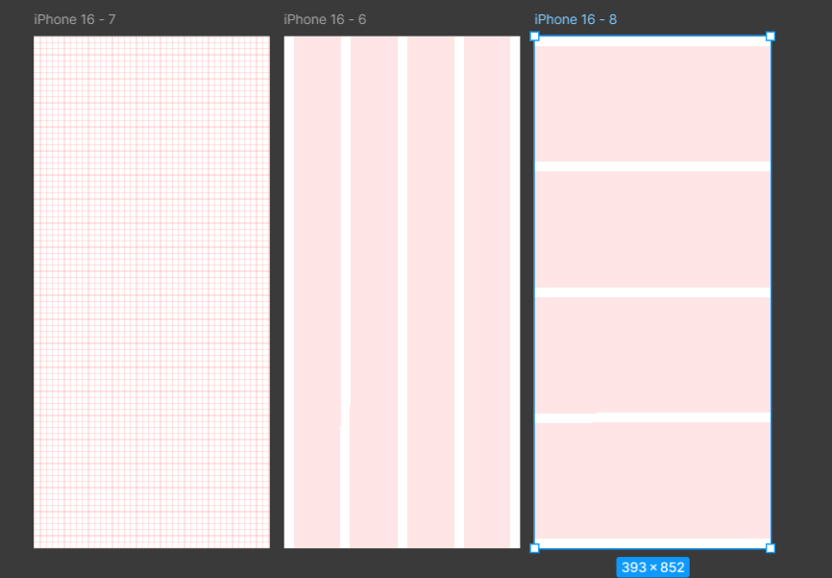
Types of Layout Grids in Figma
1. Grid (Square)
Displays a uniform square grid.
Great for icon design, spacing, and pixel-perfect work.
2. Columns
Vertical divisions for responsive web and app design.
Best for layout alignment (e.g., 12-column web grid).
3. Rows
Horizontal divisions; used with columns in complex layouts.
Helpful for dashboards or data-heavy screens.
Grid
Columns
Row

Slide 6
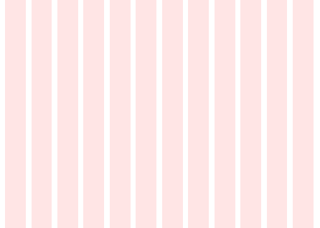
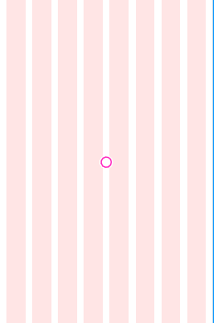
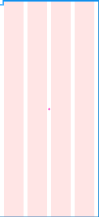
Common Settings for Column Grids
Desktop
Tablet
Mobile
Screen Type | Columns | Margin | Gutter
Desktop | 12 | 24-32 px | 16-24 px
Tablet | 8 | 16-24 px | 16 px
Mobile | 4 | 16 px | 8 px

Slide 7
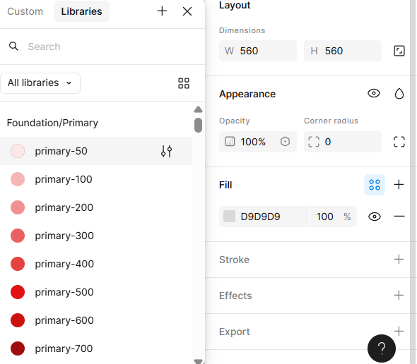
Color styles and visual aesthetics
Figma provides powerful tools like color styles, text styles, and components that help maintain visual consistency throughout mobile and tablet interfaces.
What are Color Styles in Figma?
Color Styles in Figma are reusable color definitions that can be applied across multiple elements.
When a color style is updated, all elements linked to that style automatically update — ensuring consistency and saving time.
Click “Create style” & name it clearly
Style icon

Slide 8
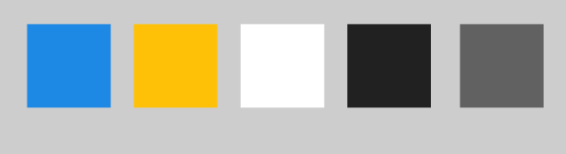
Example
Primary
Secondary
Background
Text primary
Text Secondary
Role | Name | Hex code | Usage
Primary | Blue / 500 | #1E88E5 | Buttons, highlights
Secondary | Amber / 300 | #FFC107 | Accent elements
Background | Light / 50 | #FFFFFF | Screen background
Text primary | Grey / 900 | #212121 | Headings
Text Secondary | Grey / 600 | #616161 | Body text

Slide 9
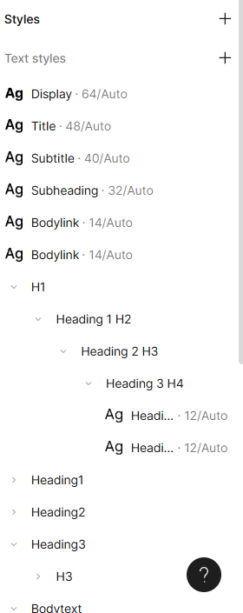
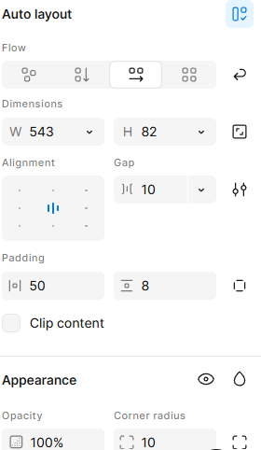

Visual Aesthetic Principles in Figma
A good visual aesthetic is achieved by balancing color, typography, spacing, and hierarchy.
Key Practices :
Use consistent typography: Create text styles (e.g., H1, H2, Body, Caption).
Maintain spacing: Use an 8px base grid for padding and margins.
Apply corner radius- 8px
Gap
Maintain spacing
Corner radius

Slide 10
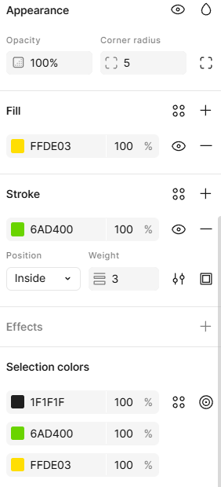
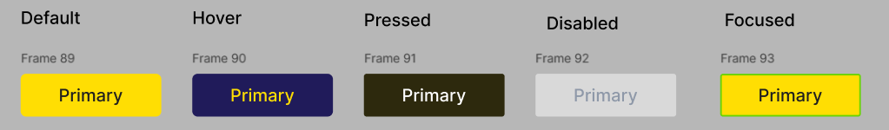
Use fill, stroke, blending modes, and opacity to create visual contrast
Fill : The Fill property in Figma is used to apply color, gradient, or image to an object’s interior.
Stroke : A Stroke is an outline or border applied to elements to create separation or structure.
Blending Modes : Blending modes control how colors and layers visually interact when they overlap.
Opacity : Opacity controls how transparent or solid an element appears.
(0% = completely transparent, 100% = fully visible.)

Slide 11

Ensure colors are applied consistently across all UI components
Here, we can see that the designer has effectively used a single primary color (yellow) and a neutral color scheme (black & white) throughout the interface.

Slide 12
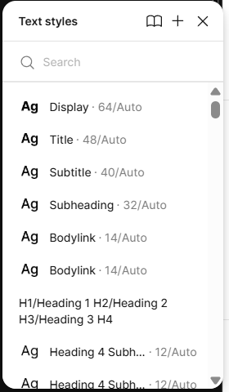
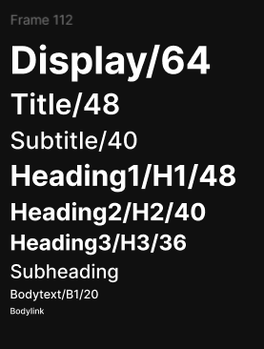
3. Text styles for typography consistency
Text style for typography consistency refers to a predefined set of font properties — such as font family & size.
By defining text styles (like Heading, Subtitle, Body, and Caption), designers ensure that typography looks uniform across all screens and components.
Purpose:
Maintains visual consistency
Improves readability and hierarchy
Makes design scalable and easy to update
Text style set

Slide 13
4. Auto layout
Auto Layout organizes UI components automatically, ensuring your design stays neat, balanced, and adaptive — no matter how the content changes.
Constraints :
Constraints define how UI elements stay positioned or resize when the screen or frame changes — ensuring your layout remains consistent and responsive.
Left | Keeps the element fixed to the left edge
Right | Keeps the element fixed to the right edge
Top | Keeps the element fixed to the top edge
Bottom | Keeps the element fixed to the bottom edge
Center | Keeps the element centered horizontally or vertically
Scale | Stretches or scales element proportionally

Slide 14
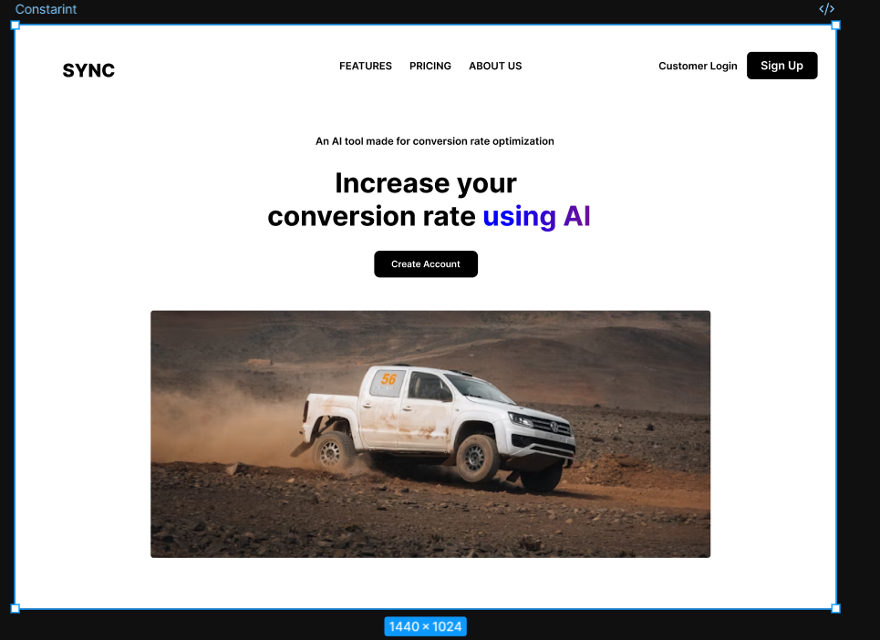
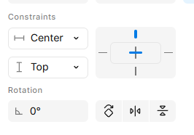
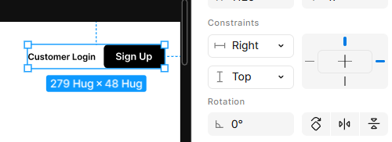
Here we apply constraints to ensure the design adapts responsively across different screen sizes.

Slide 15
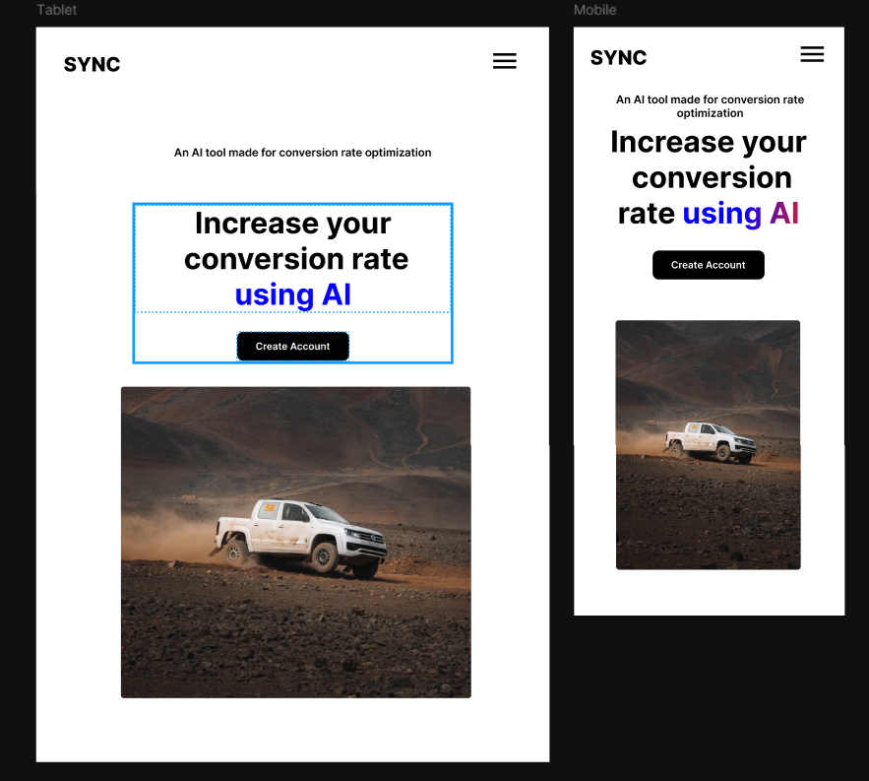
Here we can see the screen of tablet and mobile.
https://www.figma.com/design/SMGrF6TlEhaU3qjViP988m/Mayuri?node-id=686-1208&t=BH6PqJTsjPUzgPDZ-1

Slide 16
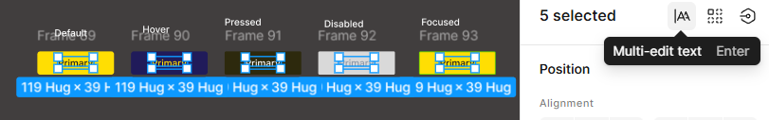

Multi edit text
Multi-edit text allows designers to select multiple text elements and edit their shared properties simultaneously.
Select multiple text layers (use Shift + Click or Ctrl/Cmd + Click).
Edit any shared property in the right-hand panel (e.g., font family, size, color).
All selected text layers update together instantly.

Slide 17
Thank you..

